Slide 1
Thermal and structural analysis of a 3-phase transformer with short circuit connection
Short Circuit – Transformer 3 Phase

Slide 2
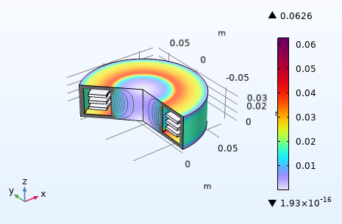
Goal
Thermal and structural analysis of a 3- phase transformer
Using primary and secondary windings on the secondary side of the transformer,
a short circuit (i.e., a fault) and after that short circuit, the voltage naturally drops and the current increases sharply.

Slide 3
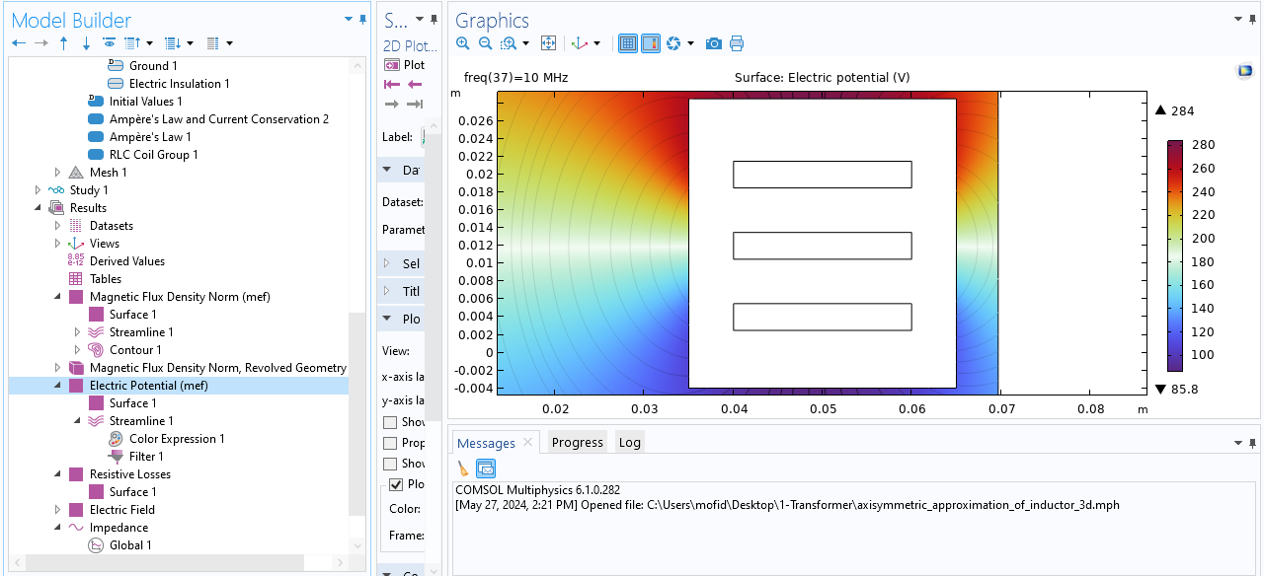
Desired results
The results showed that the electrical voltage decreased with increasing current.

Slide 4
Transformer structure
A transformer is a device that transfers electrical energy between two or more windings through electromagnetic induction. In this way, a varying current in the primary winding of the transformer produces a varying magnetic field in the transformer core, and the effect of the varying magnetic field leads to the creation of a voltage in the secondary winding.

Slide 5
Transformer structure
One of the important applications of transformers is to reduce the current in electrical energy transmission lines. The reason for using transformers at the beginning of the lines is that all electrical conductors have electrical resistance. This resistance can cause energy loss along the electrical energy transmission path. The amount of losses in a conductor is directly related to the square of the current passing through the conductor, and therefore, by reducing the current, losses can be greatly reduced. As the voltage in the transmission lines increases, the line current decreases in the same proportion, and thus the energy transmission costs are also reduced. Of course, as the transmission lines approach the consumption centers to increase the safety of the lines, the voltage is reduced in several stages and again by transformers until it reaches the standard consumption level. Thus, without the use of transformers, it is not possible to use distant energy sources.

Slide 6
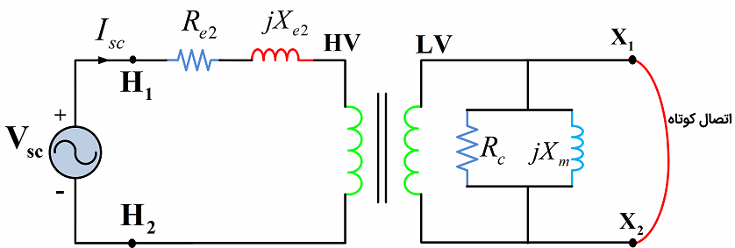
Transformer short circuit
In the short-circuit test, we vary the voltage until the rated short-circuit current flows through the windings. This voltage is usually much smaller than the rated voltage, between 0.05 and 0.1 per unit. Therefore, the magnetizing branch current can be neglected. It can also be assumed that a voltage drop occurs in the series impedance of the transformer.

Slide 7
Transformer structure
When a three-phase transformer is subjected to open-circuit and short-circuit tests, its three-phase power, line-to-line voltage, and line current must be measured. The impedance parameters are also calculated for each phase. Therefore, before using the above formulas to calculate resistances and reactances, the measured values must be converted to values for each phase.

Slide 8
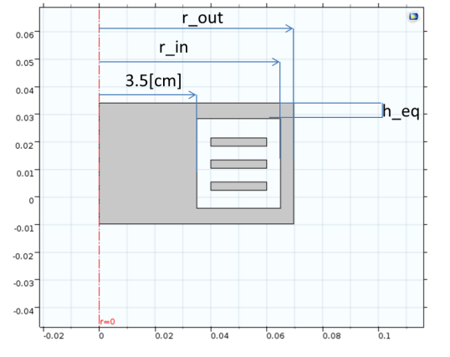
Transformer implementation in COMSOL

Slide 9
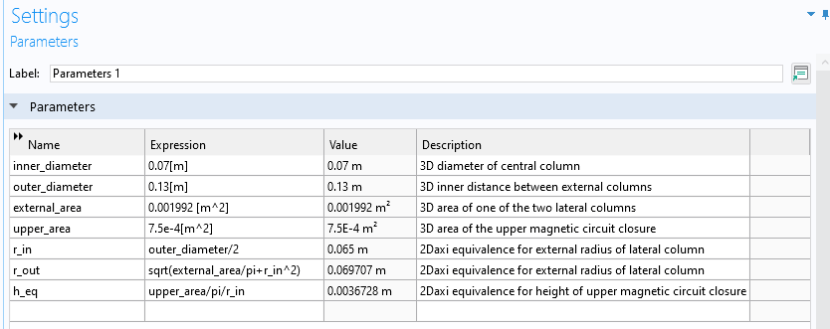
Transformer implementation in COMSOL

Slide 10
3D thermal and structural analysis results Comsol

Slide 11


Question regarding the presentation of 3D results of thermal and structural analysis of a 3-phase COMSOL transformer
Notes:
In Slide Show mode, select the arrows to visit links.

